Slide 1
Object Oriented Programming—C++ Lecture 1: Introduction
Qijun Zhao
College of Computer Science
Sichuan University
Spring 2025

Slide 2
Something you should already know

Slide 3
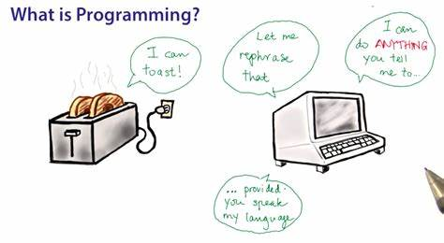
What does programming mean to ...
What does Programming mean to the world?
What does Programming mean to you?

Slide 4
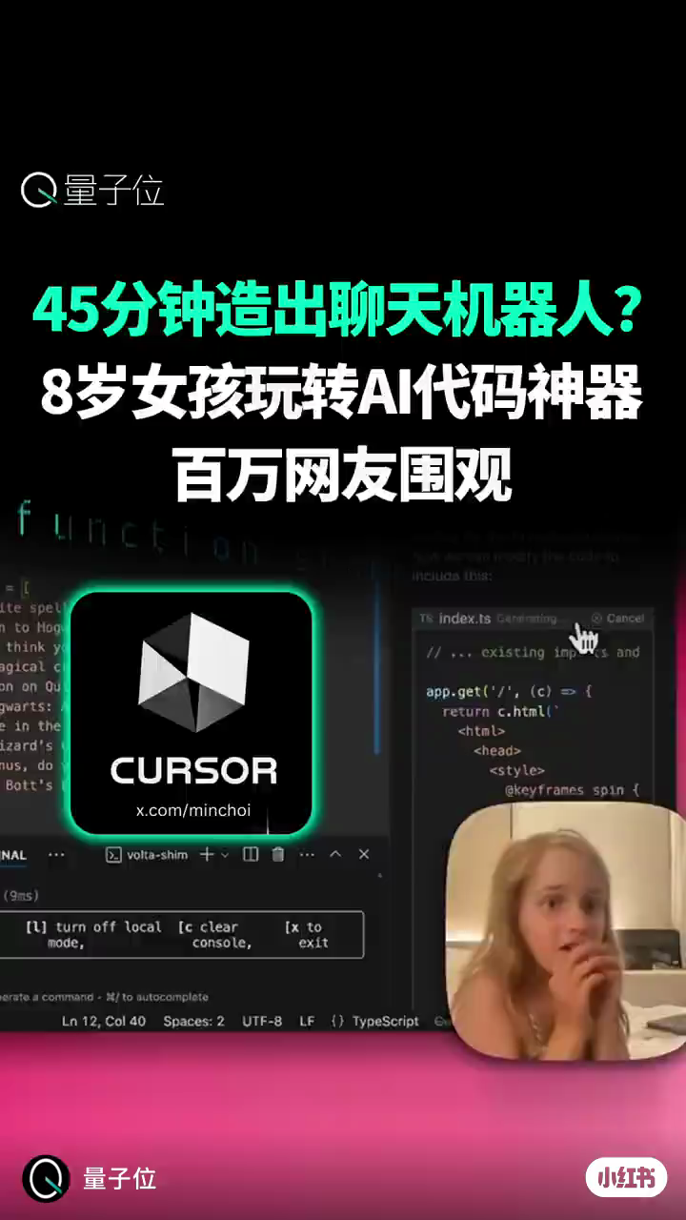
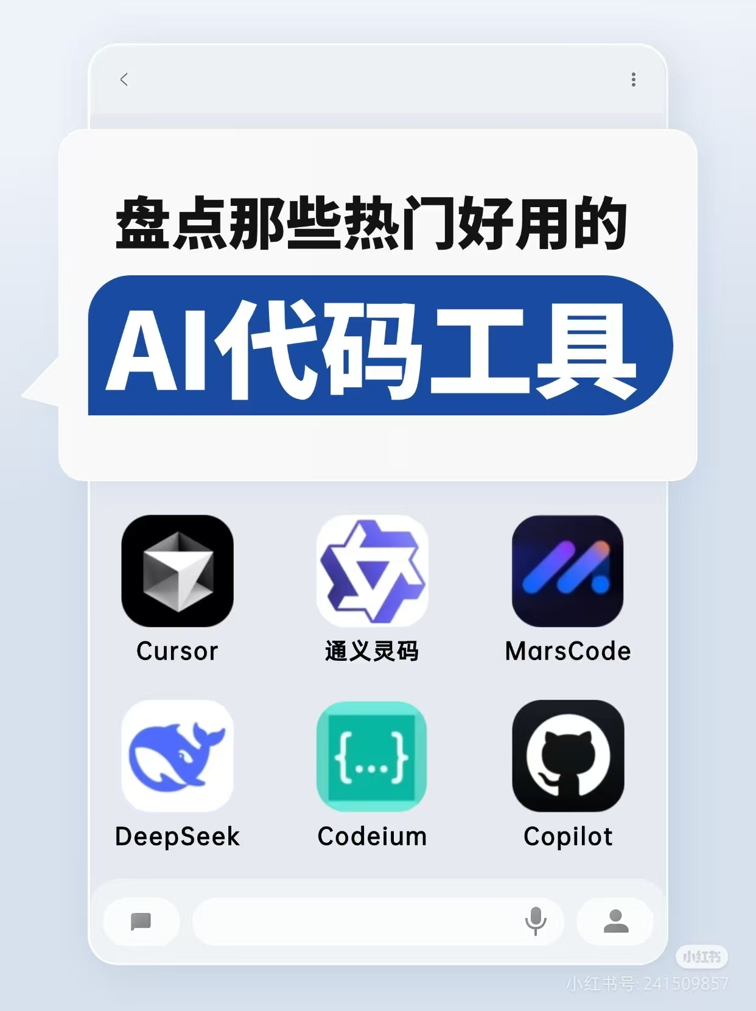

Coding with AI
Do we still need people to write code?

Slide 5
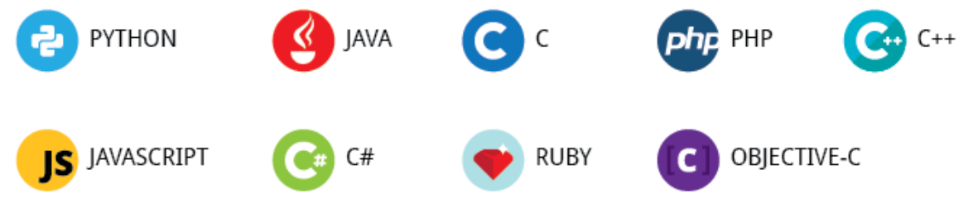
The programming languages in the world
Ruby
Javascript
Python
Java
C++
C
Assembly
Machine Code
High
Level
Low
Level

Slide 6
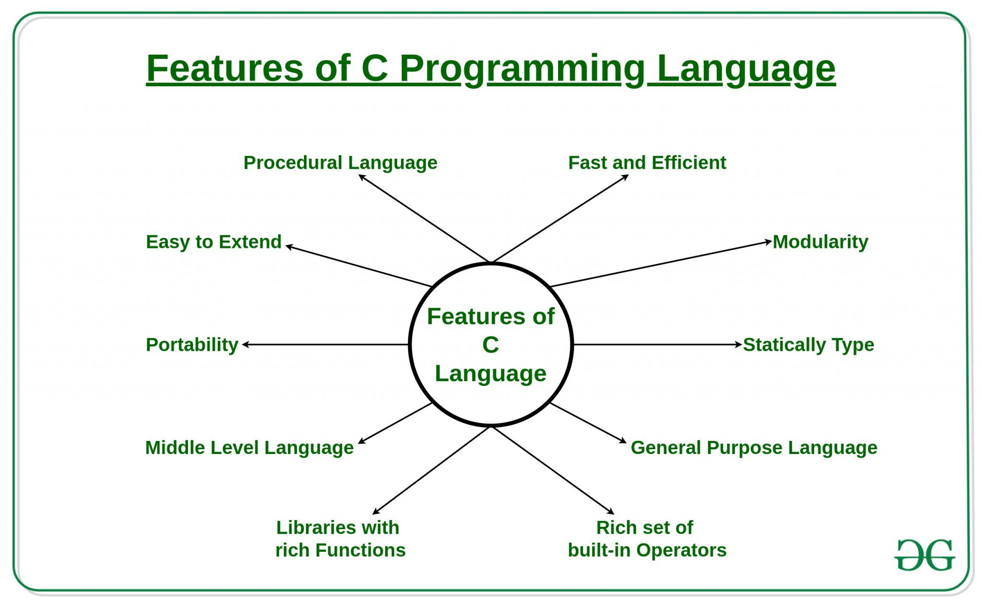
C language
https://help.rerfindia.org/lib-html/c-lang-tutorial/intro-feature-c/

Slide 7
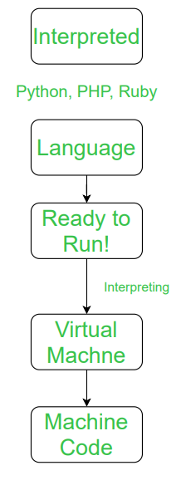
Interpreted Language vs. Compiled Language
An interpreted language is a programming language that is generally interpreted, without compiling a program into machine instructions. It is one where the instructions are not directly executed by the target machine, but instead, read and executed by some other program.
Interpreted language ranges – JavaScript, Perl, Python, BASIC, etc.

Slide 8
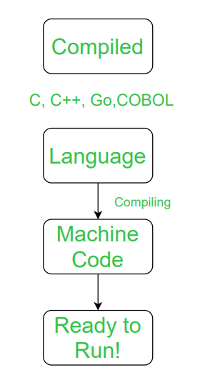
Interpreted Language vs. Compiled Language
A compiled language is a programming language that is generally compiled and not interpreted. It is one where the program, once compiled, is expressed in the instructions of the target machine; this machine code is undecipherable by humans.
Types of compiled language – C, C++, C#, CLEO, COBOL, etc.

Slide 9
Difference between Compiled and Interpreted Language
NO. | COMPILED LANGUAGE | INTERPRETED LANGUAGE
1 | A compiled language is a programming language whose implementations are typically compilers and not interpreters. | An interpreted language is a programming language whose implementations execute instructions directly and freely, without previously compiling a program into machine-language instructions.
2 | In this language, once the program is compiled it is expressed in the instructions of the target machine. | While in this language, the instructions are not directly executed by the target machine.
3 | There are at least two steps to get from source code to execution. | There is only one step to get from source code to execution.
4 | In this language, compiled programs run faster than interpreted programs. | While in this language, interpreted programs can be modified while the program is running.
5 | In this language, compilation errors prevent the code from compiling. | In this languages, all the debugging occurs at run-time.
6 | The code of compiled language can be executed directly by the computer’s CPU. | A program written in an interpreted language is not compiled, it is interpreted.
7 | This language delivers better performance. | This language delivers relatively slower performance.
8 | Example of compiled language C, C++, C#, CLEO, COBOL, etc. | Example of Interpreted language JavaScript, Perl, Python, BASIC, etc.

Slide 10
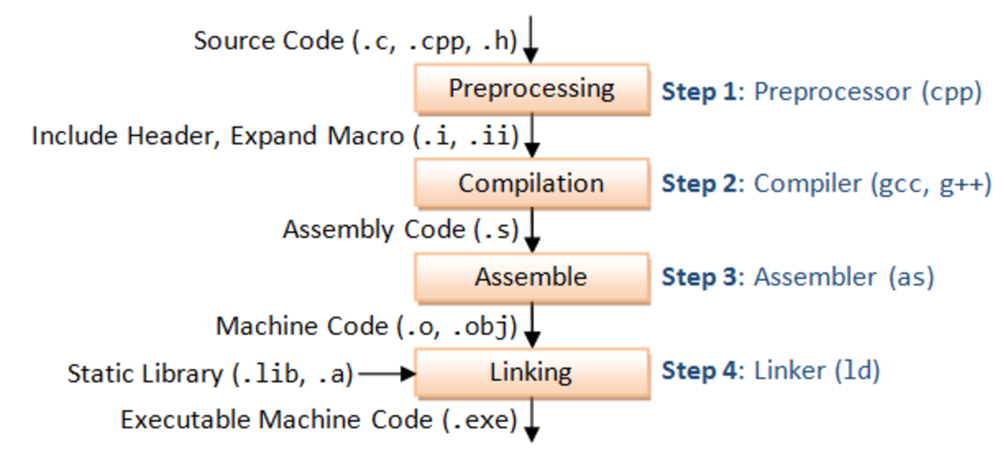
The 4 Stages of C Compilation
The compilation can split into 4 stages:
-Preprocessing
-Compilation
-Assembly
-Linking

Slide 11
About this course

Slide 12
Purpose of this course
- Exposure to standard c++ syntax and norms
- Learn key features of object oriented programming (OOP)
- Gain familiarity with powerful features of the stl
- Practice using industry standard coding tools such as ssh and VSCode

Slide 13
Teaching team
Lecturer
Prof. / Dr. Qijun Zhao
Teaching assistants
Yangqianqian Chen, A senior undergraduate student

Slide 14
Course Overview
周次 | 日期 | 理论课主题 | 内容
1（校历第1周） | 2月27日 | Introduction | Introduction of C++
2（校历第2周） | 3月6日 | Types, Initialization and References Streams Containers and Iterators | Features of C++
3（校历第3周） | 3月13日
4（校历第4周） | 3月20日
5（校历第5周） | 3月27日 | Quiz I & Mid-Term Review
6（校历第6周） | 4月3日 | Classes Concepts Inheritance Polymorphism Operator Overloading | Object Oriented Programming (OOP)
7（校历第7周） | 4月10日
8（校历第8周） | 4月17日
9（校历第9周） | 4月24日
10（校历第10周） | 5月1日
11（校历第11周） | 5月8日 | Quiz II
12（校历第12周） | 5月15日 | Modern C++ with OOP | Advanced Features of C++
13（校历第13周） | 5月22日
14（校历第14周） | 5月29日 | Project Reporting
15（校历第15周） | 6月5日
16（校历第16周） | 6月12日 | Final Review
Acknowledgement: Materials of this course are mainly adapted from CS106L @ Stanford.

Slide 15
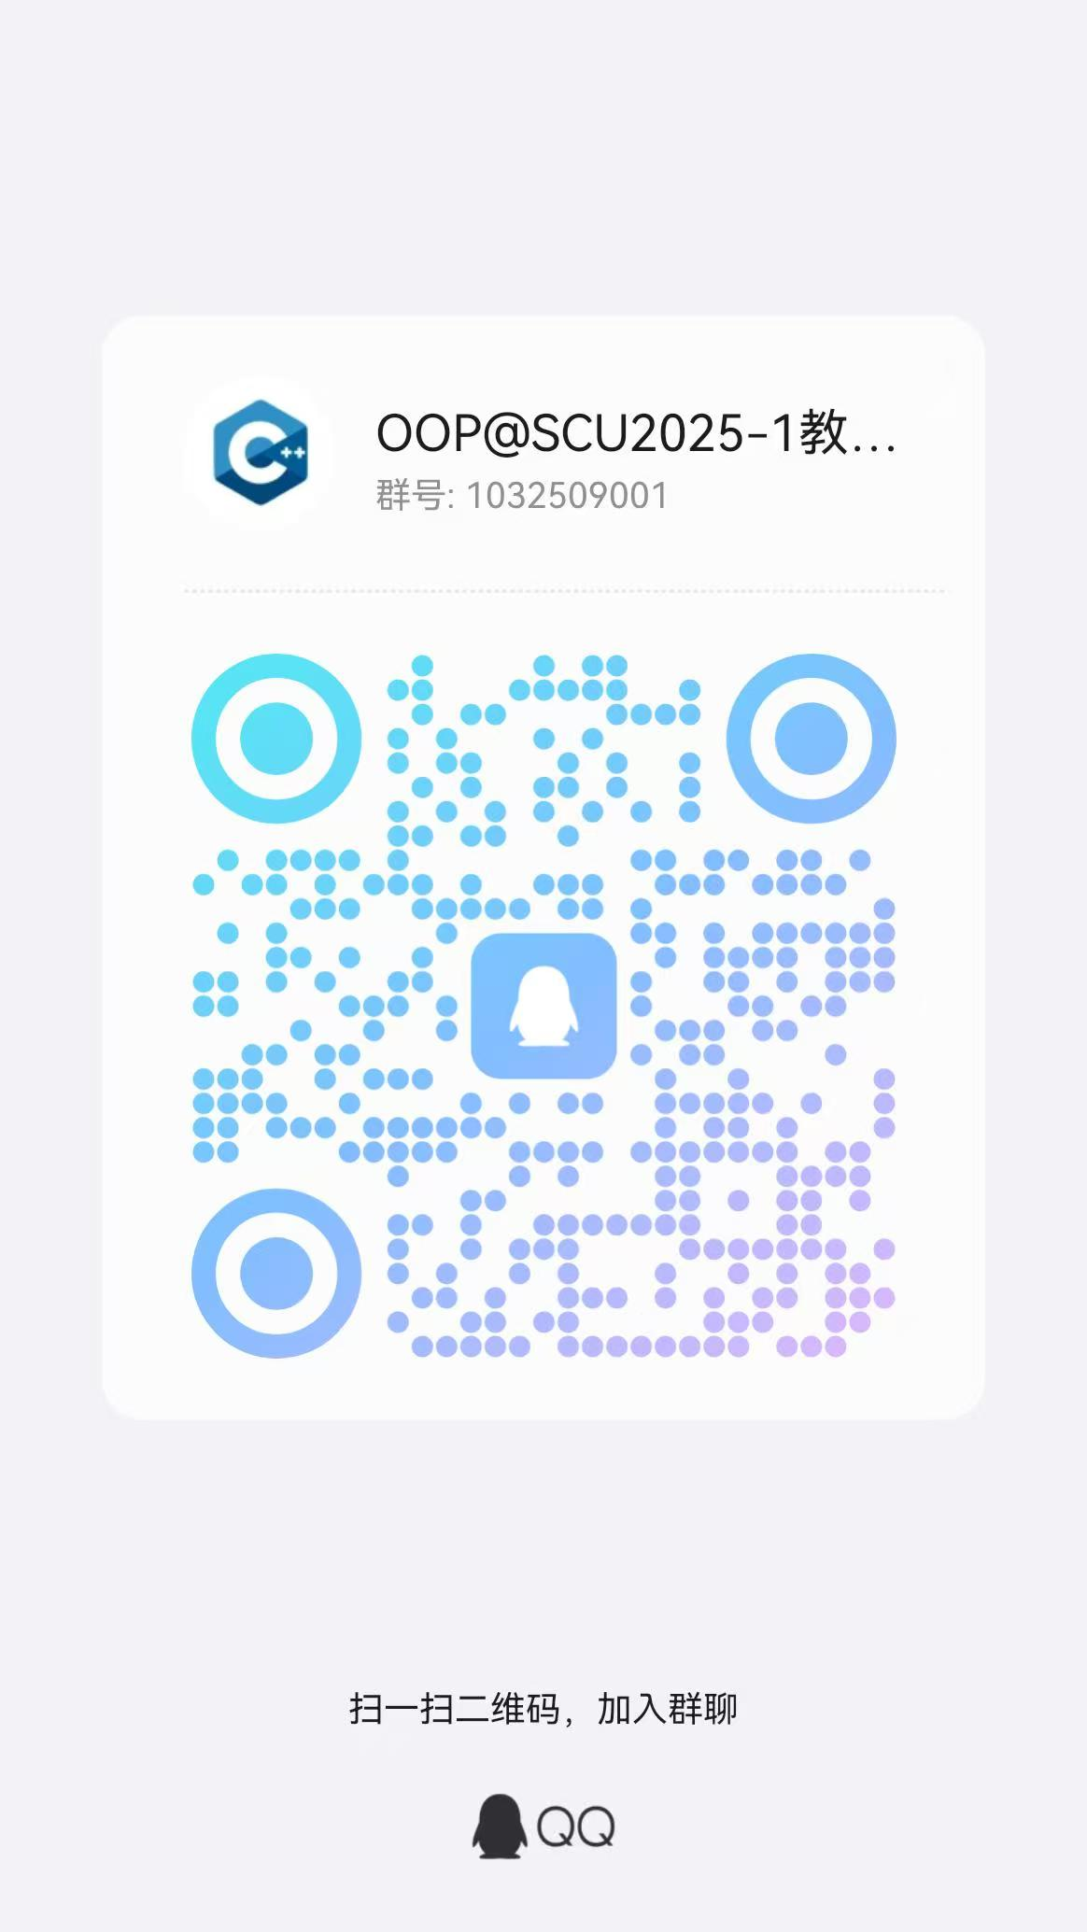
Course Grade Composition
Attendance & On-class Performance | 10%
Assignment | 20%
Quiz I | 20%
Quiz II | 20%
Final Exam | 30%

Slide 16
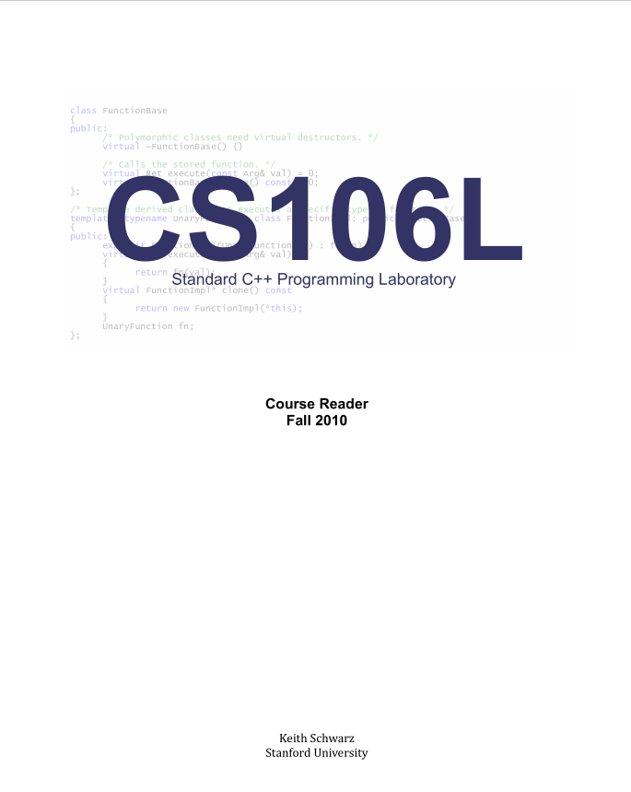
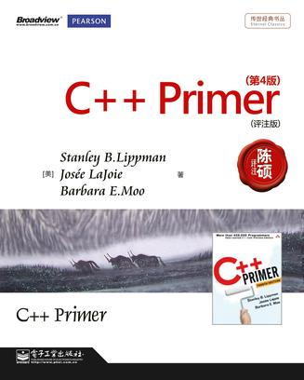
Reader
https://en.cppreference.com/w/
https://github.com/federico-busato/Modern-CPP-Programming
https://timsong-cpp.github.io/cppwp/
https://stackoverflow.com/questions/388242/the-definitive-c-book-guide-and-list

Slide 17
Why C++?

Slide 18
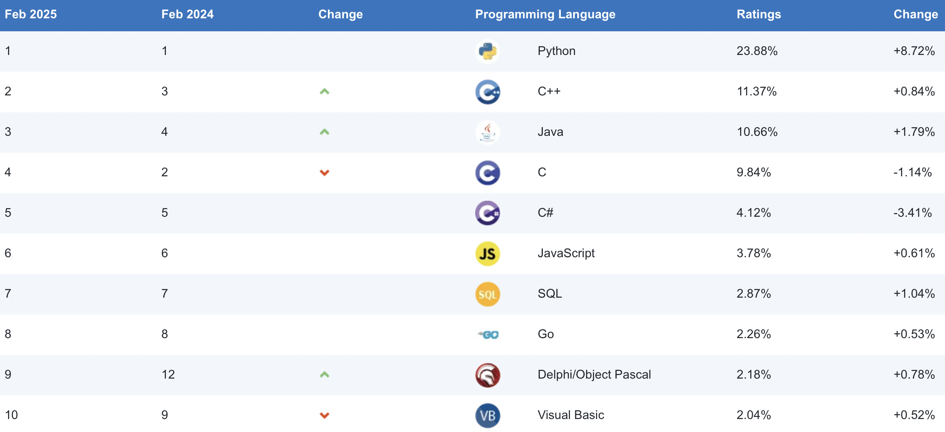
Why C++?
C++ is still a very popular language！
Tiobe Index： https://www.tiobe.com/tiobe-index/

Slide 19
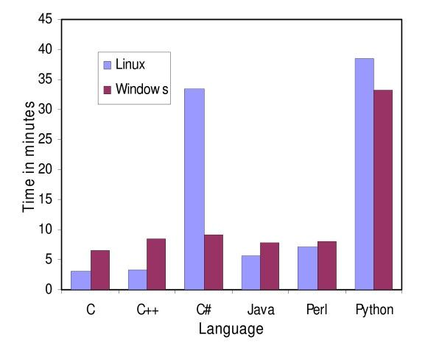
Why C++?
FAST
Ruby
Javascript
Python
Java
C++
C
Assembly
Machine Code
High
Level
Low
Level
Influenced by compiler, hardware, os ……

Slide 20
History and Design Philosophy of C++

Slide 21
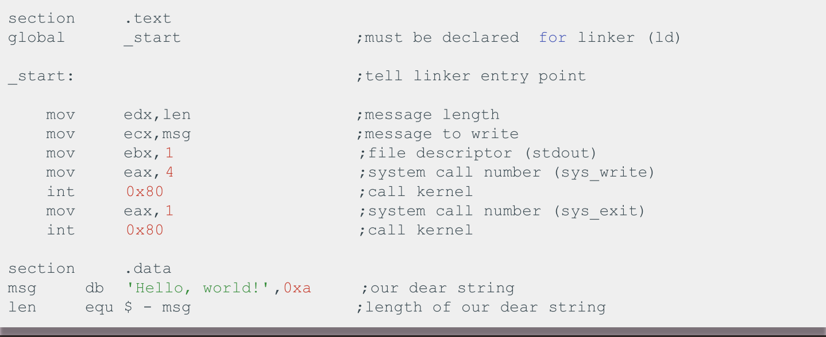
C++ History: Assembly

Slide 22
C++ History: Assembly
- Unbelievably simple instructions
- Extremely fast (when well-written)
- Complete control over your program
Why don’t we always use Assembly?

Slide 23
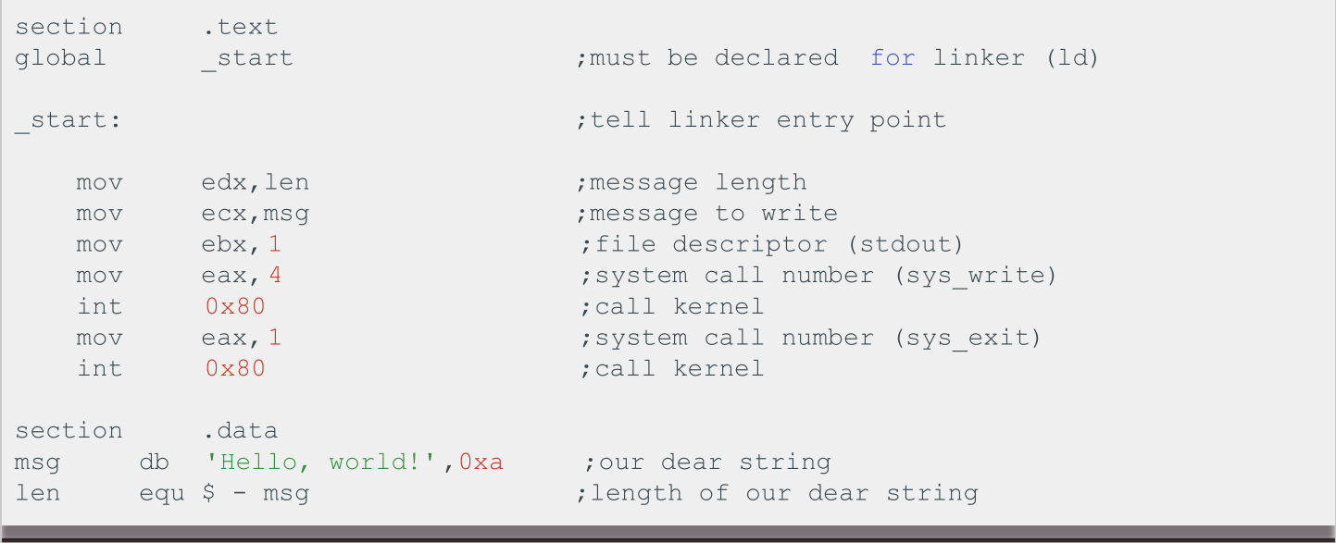
C++ History: Assembly
Assembly looks like this

Slide 24
C++ History: Assembly
Drawbacks:
- A LOT of code to do simple tasks
- Very hard to understand
- Extremely unportable (hard to make work across all systems)

Slide 25
Next in C++ History
Invention of C
Problem: computers can only understand assembly!
- Idea:
- Source code can be written in a more intuitive
language
- An additional program can convert it into assembly
- This additional program is called a compiler!

Slide 26

C++ History: Invention of C
- T&R created C in 1972, too much praise
- C made it easy to write code that was
■ Fast
■ Simple
■ Cross-platform
Ken Thompson and Dennis Ritchie, creators of the C language.

Slide 27
C++ History: Invention of C
- C was popular because it was simple.
- This was also its weakness:
- No objects or classes
- Difficult to write generic code
- Tedious when writing large programs

Slide 28
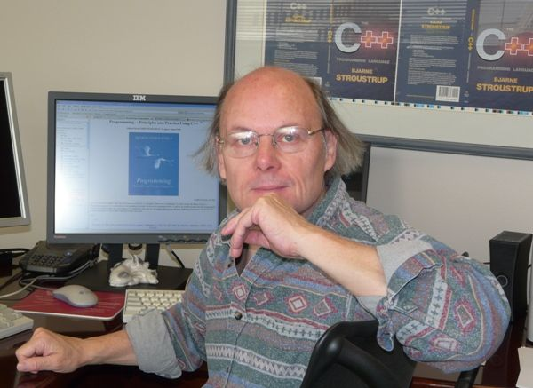
C++ History: Welcome to C++!
- In 1983, the beginnings of C++ were created by
Bjarne Stroustrup.
- He wanted a language that was:
- Fast
- Simple to use
- Cross-platform
- Had high-level features

Slide 29
C++ History: Evolution of C++
We are here
C++
C++ 03
C++ 14
C++ 20
C++ 26
1979
1983
1998
2003
2011
2014
2017
2020
2023
2026
C with
Classes
C++ 98
C++ 11
C++ 17
C++ 23

Slide 30
Design Philosophy of C++
- Only add features if they solve an actual problem
- Programmers should be free to choose their own style
- Compartmentalization is key
- Allow the programmer full control if they want it
- Don’t sacrifice performance except as a last resort
- Enforce safety at compile time whenever possible

Slide 31
First C++ Program

Slide 32
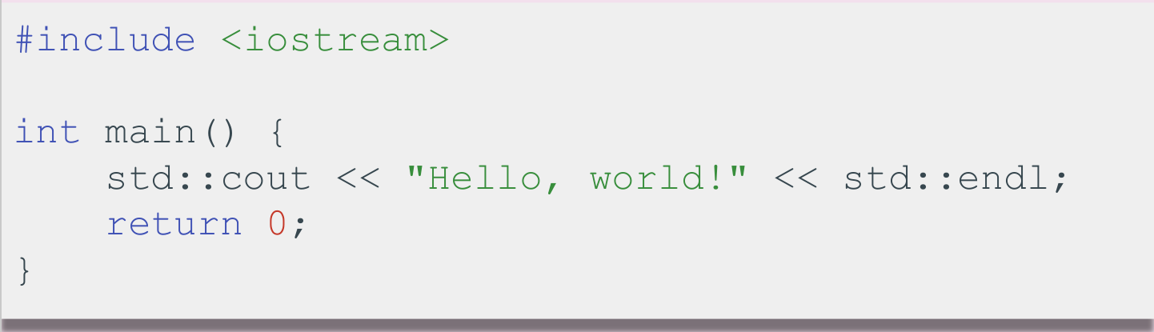
First C++ Program

Slide 33
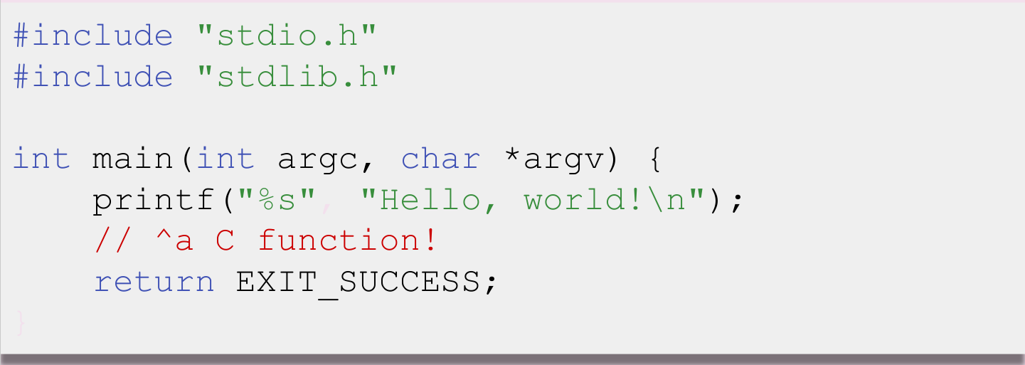
First C++ Program: Compare with C

Slide 34
But... What is C++?

Slide 35
C++: Basic Syntax & the STL
Basic syntax
- Semicolons at EOL
- Primitive types (ints,doubles etc)
- Basic grammar rules
The STL
- Tons of general functionality
- Built in classes like maps, sets, vectors
- Accessed through the namespace std::
- Extremely powerful and well-maintained

Slide 36
How to learn and practice?

Slide 37
Discussion : OOP & POP
- Practice : Library Management System
Initial Functionality : Basic Information Recording
Title
Author
Book ID
Borrowing Status
……
- Implemented in OOP & C

Slide 38

Discussion : OOP & POP
Extended Functions:
Borrowing Books
Add Book Type: "Novel" "Textbook"
Returning Books
Purchase of Books
Delete
……

Slide 39
Discussion : OOP & POP
Problems that may be found:
The increasing number of functions leads to a complex code structure.
Frequent modification of existing functions increases the risk of errors.
Code redundancy, poor maintainability
.……
That's why we need OOP!

Slide 40
Coding to make the world better
Qijun Zhao
qjzhao@scu.edu.cn

